Slide 1
QXU4004 Eng. Chemistry
Dr Sulafudin Vukusic s.vukusic@qmul.ac.uk

Slide 2
Week 3
Valence Theory and Lewis Structures（路易斯结构）
Suggested Reading List:
Chapter 8: Brown et al. Chemistry the central science,14th int Ed, Pearson / ISBN:978-1-292-02152-2

Slide 3
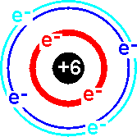
Valence（价） Electrons
The valence electrons are the electrons in the last shell or energy level of an atom.
H 1s¹
Be 1s² 2s²
B 1s² 2s²2p¹
www.uoregon.edu
Carbon - 1s²2s²2p² - four valence electrons

Slide 4
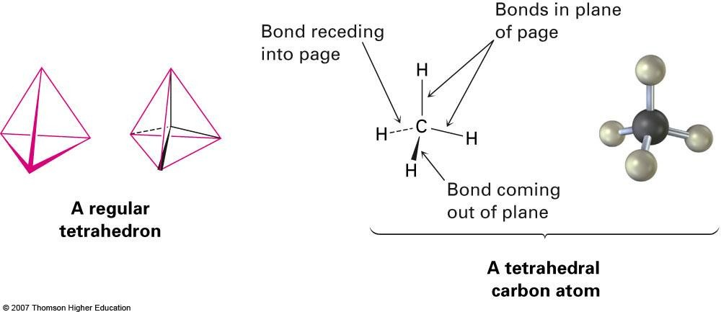
Development of Chemical Bonding Theory
Kekulé and Couper independently observed that carbon
always has four bonds
van't Hoff and Le Bel proposed that the four bonds of
carbon have specific spatial directions
– Atoms surround carbon as corners of a tetrahedron（四面体）

Slide 5
Atoms form bonds because the compound that results is more stable than the separate atoms (We have seen how Molecular Orbital Theory explains this)
Ionic bonds in salts form as a result of electron transfers and electrostatic attraction between opposite charges
Organic compounds have covalent bonds共价键 from sharing electrons (G. N. Lewis, 1916)

Slide 6
Drawing molecule structures
Lewis structures (“electron dot”) show valence
electrons of an atom as dots
Hydrogen has one dot, representing its 1s electron
Carbon has four dots (2s² 2p²)
Kekule凯库勒structures (line-bond structures) have a line drawn between two atoms indicating a 2 electron covalent bond.
Stable molecule results at completed shell, octet (eight dots) for main-group atoms (two for hydrogen)
Lewis and Kekule structures are sometimes are combined leaving lines representing bonds (Kekule) and dots for lone pairs (Lewis)

Slide 7
Valence electrons and bonds
Atoms with one, two, or three valence electrons form one, two, or three bonds.
Atoms with four or more valence electrons form as many bonds as they need electrons to fill the s and p levels of their valence shells to reach a stable octet.
Carbon has four valence electrons (2s² 2p²), forming four bonds (CH₄).

Slide 8
Nitrogen has five valence electrons (2s² 2p³) but forms only three bonds (NH₃).
Oxygen has six valence electrons (2s² 2p⁴) but forms two bonds (H₂O)

Slide 9
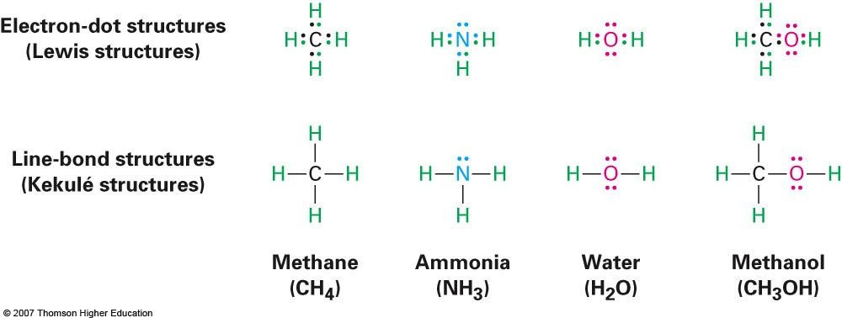
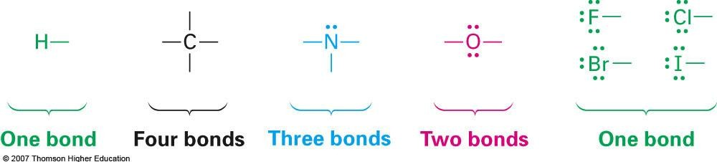

Slide 10
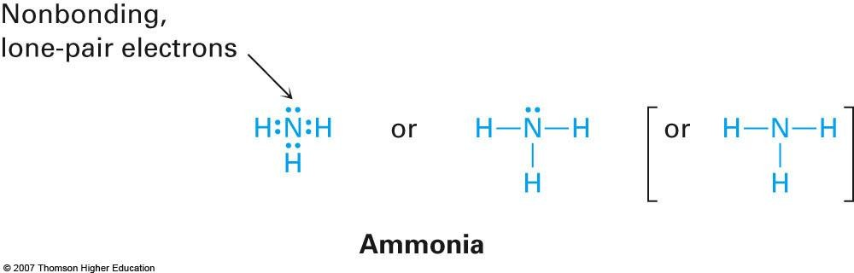
Non-bonding electrons
Valence electrons not used in bonding are called
nonbonding electrons, or lone-pair electrons（孤对电子）
Nitrogen atom in ammonia (NH₃)
Shares six valence electrons in three covalent bonds and remaining two valence electrons are nonbonding lone pair

Slide 11
Lewis Symbols
Represent the number of valence electrons as dots
Valence number is the same as the Periodic Table（周期表） Group Number
n = 1
H
n = 2
Li
Be
2
Groups 1
3
4
5
6
7
8
For example,
Na; Is², 2s², 2p⁶, 3s¹ = [Ne] 3s¹
Lewis Structure = Na

Slide 12
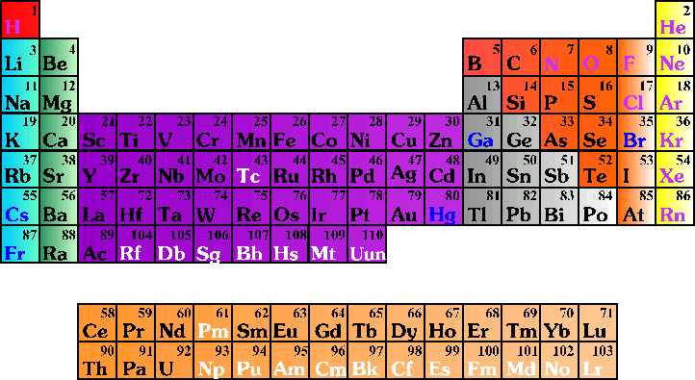
Elements want to achieve the stable electron configuration
of the nearest noble gas（惰性气体）
n = 2
n = 3
Ne
Atoms tend to gain, lose or share electrons
until they are surrounded by 8 electrons
Octet Rule（八角定则）

Slide 13
There are two types of bonding (as far as Lewis is concerned);
Ionic Bonding refers to electrostatic forces between ions（离子）, usually a metal cation and a non-metal anion
Covalent Bonding results from the sharing of two electrons between two atoms (usually non- metals) resulting in molecules

Slide 14
Ionic Bonding – Electrostatic attraction between cation（正离子） and anion（负离子）
Nobel Gas Has a Stable Electron Configuration
Ne; 1s², 2s², 2p⁶ Ar; [Ne] 3s²
Example of Ionic Bonding
Na
11
+
F
9 10
Electronic configuration of Neon achieved in both cases

Slide 15
Covalent Bonding – Atoms Share Electrons
Octet Rule applies
H H
number of electrons around each atom = He
Cl Cl
number of electrons around each atom = Ar
H
+
H
Cl + Cl
N
+
N
Triple bond
N N
number of electrons around each atom = Ne
Each Covalent Bond contains two electrons

Slide 16
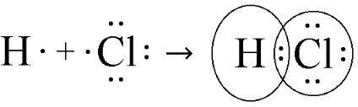
Covalent Bonding – Atoms Share Electrons
Carbon has 4 valence electrons
H
H C H
H
C H
H
H
Ne
Neon
H
methane
H C
Stable Octet required

Slide 17

Hydrogen molecule, H₂
Concentration of negative charge between two nuclei occurs in a covalent bond
7A elements (e.g. F) use one valence electron for covalent bonding, so
to achieve octet
6A elements (e.g. O) use two valence electrons for covalent bonding,
so to achieve octet
5A elements (e.g. N) use three valence electrons for covalent bonding, so to achieve octet
4A elements (e.g. C) use four valence electrons for covalent bonding, so to achieve octet

Slide 18


Rules for Drawing Lewis Structures
First sum the number of valence electrons from each atom
The central atom is usually written first in the formula
Complete the octets of atoms bonded to the central atom
(remember that H can only have two electrons)
Place any left over electrons on the central atom, even if doing so it results in more than an octet
If there are not enough electrons to give the central atom an
octet , try multiple bonds
Carbon dioxide, CO₂
Total Number of valence electrons = 4 + (2 x 6) = 16
O + C +
C
O
O O = O O
C
Double bonds

Slide 19



E.g. 1.
PCl₃
Total Number of valence electrons = 5 + (3 x 7) = 26
Cl P C
Cl P Cl Cl
Cl P Cl Cl
E.g. 2; CHBr₃
Total Number of valence electrons = 4 + 1 + (3 x 7) = 26
Br
Br

Slide 20
Exceptions to the Octet Rule in Covalent Bonding
Molecules with an odd number of electrons
Other Natural Radicals, which do not obey Lewis Structures
(e.g. O₂) (“Radicals” are species with reactive unpaired electrons: we do not use this term for metals: “radicals” are species formed from molecule fragments, although some are stable molecules)
Molecules in which an atom has less e⁻ than an octet (B)
Molecules in which an atom has more e⁻ than an octet (Period 3 elements and below can expand octet using 3d-4d etc-orbitals.). These are called hypervalent（超价的）.

Slide 21
1. Odd Number of Electrons
NO
Number of valence electrons = 11
N O
N O
Resonace Arrows
Resonance occurs when more than one valid Lewis structure can be written for a particular molecule (i.e. rearrange electrons) (See separate notes and video on resonance)
NO₂
Number of valence electrons = 17
O N O O N O O N O
Molecules and atoms which are neutral (contain no formal charge) and with an unpaired electron are called Radicals（自由基）
O₂
O O
Oxygen is a ground state "diradical"
O O

Slide 22
2. Less than an Octet
Includes Lewis acids such as halides of B, Al and compounds of Be
BCl₃
Cl B
Group 3A atom only has six electrons around it
Cl Cl
However, Lewis acids “accept” a pair of electrons readily from
Lewis bases to establish a stable octet
Cl H
Cl Al + N H
Cl H
Cl
H
_ +
Cl Al N H
H
Cl
Lewis acid
Lewis base （碱）
salt

Slide 23
AlCl₃
Aluminium chloride is an ionic solid in which Al³⁺ is surrounded by six Cl⁻. However, it sublimes at 192 °C to vapour Al₂Cl₆ molecules（coordinate bond配位键）
B₂H₆
A Lewis structure cannot be written for diborane.（ 乙硼烷）
This is explained by a three-centre bond – single electron is delocalized over a B-H-B
H
H H
H
H
B
B
H

Slide 24


Octet Rule Always Applies to the Second Period = n² ; number of orbitals
2s, 2p_{x}, 2p_{y}, 2p_{z} ---orbitals cannot hold more than two electrons
Ne [He]; 2s², 2p_{x}², 2p_{y}², 2p_{z}
2
n = 2
n = 3

Slide 25
Third Period ; n² = 3² = 9 orbitals
Ar [Ne]; 3s², 3p_{x} , 3p_{y} , 3p_{z} 3d
2 2 2 0
n = 3

Slide 26

3. More than an Octet
Elements from the third Period and beyond, have ns, np and unfilled
nd orbitals which can be used in bonding
PCl₅
P : (Ne) 3s² 3p³ 3d⁰
Number of valence electrons = 5 + (5 x 7) = 40
Cl
Cl P
Cl
10 electrons around the phosphorus
_{Cl} Cl
SF₄
S : (Ne) 3s² 3p⁴ 3d⁰
Number of valence electrons = 6 + (4 x 7) = 34
F
F
S
The Larger the central atom, the more atoms you can bond to it – usually small atoms such as F, Cl and O allow central atoms such as P and S to expand their valency.
F
F

